Slide 1

Turning Tracy Using Angles
Notes:
Hi, in this video we’re going to learn how to make Tracy turn in order to complete more advanced challenges.

Slide 2
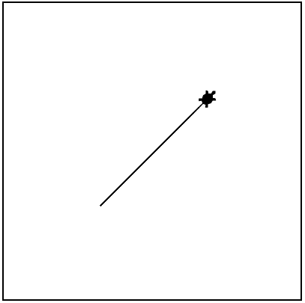
Turning Tracy- Limitations
What if we want Tracy to draw diagonal lines?
Right now, Tracy can only turn at 90 degree angles but we need her to be able to turn at any angle we wish.
Notes:
Right now, Tracy can only turn 90 degrees left or right but what if we want Tracy to draw diagonal lines for us? We need to be able to turn her at any angle we wish.

Slide 3
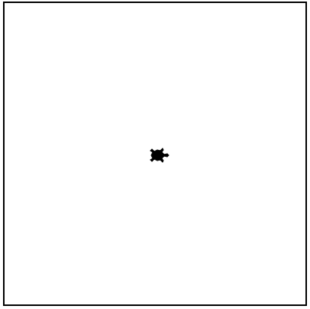

Advanced Turning Commands
left(angle)
right(angle)
Turns Tracy left at a specified angle
Turns Tracy right at a specified angle
left(45)
right(45)
Notes:
Instead of putting a 90 between the parentheses after a left or right command, we can place any angle we want and Tracy will turn that many degrees to the left or right.
Before we jump into writing code using angles, let’s learn a few more commands that will make it easier for us to write more advanced programs.

Slide 4
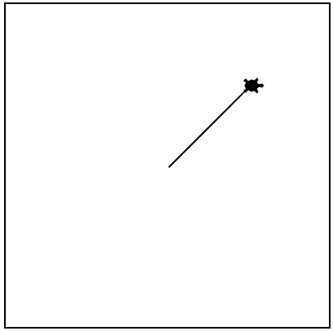
Tracy Command: setposition
setposition(x, y)
Moves Tracy to a specified coordinate
setposition(100,100)
Notes:
We can more immediately move Tracy around the grid world by using the ‘setposition’ command which will have Tracy move directly to that spot in a straight line. If you have not called the ‘penup’ command before using this command, she will leave a trail as she goes from her current position to the position you have called. You will notice that the direction Tracy is facing does not change when you set her position, so if she was facing left before the command was called, she will still be facing left after moving.

Slide 5
Tracy Command: speed
speed(number 0-10)
Sets how quickly Tracy will move through commands
speed(1)
speed(5)
speed(10)
speed(0)
Slowest
Medium
Very Fast
Immediate
Notes:
We have another command that doesn’t have to do with moving Tracy but will make it a lot easier for us to code larger problems. That’s the speed command. You can call this command at the beginning of your code to set the speed for the entire program or call it halfway through to just slow down or speed up a certain section. To use the speed command, you type a number from 0 to 10 into the parentheses. A speed of 1 is the slowest, 10 is very fast, and 0 is almost immediate.
Let’s take a look at how we can use these commands to write some programs.

Slide 6
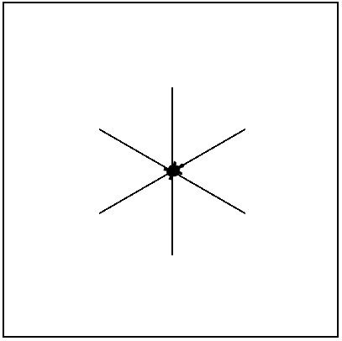
Example #1: Asterisk
Write a program that has Tracy draw an asterisk with lines 100 pixels long.
Notes:
In our first example, we want Tracy to draw an asterisk from the center of the canvas.

Slide 7
CODE EDITOR- Example #2
Asterisk
Notes:
From now on, we should start our programs with a speed statement to make it easier for us to alter Tracy’s movements as we test our code so I’ll write speed(5).
In order to have Tracy draw one line of the asterisk, we’re going to need her to move forward(100) and then backward(100) to return to the center. Let’s see how that works. ** It’s a good start but we don’t have any horizontal lines in our asterisk, so we need to turn Tracy before she starts drawing. We need the first line she draws to be 30 degrees from where she’s facing so let’s add in left(30) before she moves. ** That’s better!
Now we know a full rotation is 360 degrees and our asterisk has 6 lines evenly spaced from the center so let’s divide 360 by 6 and we get 60 degrees for each turn. Let’s write that in- left(60).
Now we want her to go forward, backward, and turn again. And we’re gonna need her to do this 6 times. What is this starting to sound like? A for loop! Let’s write a loop to repeat these commands 6 times for us.
So I’m going to initialize my loop after I turn Tracy 30 degrees because I only want her to do that at the beginning, not every time the loop repeats. So for i in range(6): and then indent these three commands. Let’s try it. ** Perfect!

Slide 8
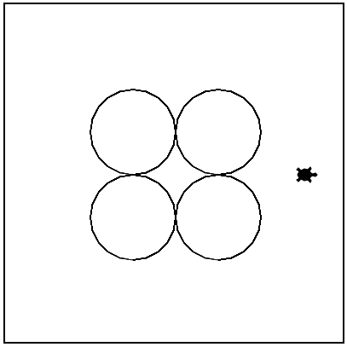
Example #2: Four Circles
Write a program that has Tracy draw four circles at the center of the canvas.
Notes:
Let’s look at a more advanced example now. In this challenge, we want Tracy to draw four circles that are centered on the canvas. We are going to have a lot of challenges that ask us to center our drawings so it is important to take some time to plan exactly how we can make this happen.

Slide 9
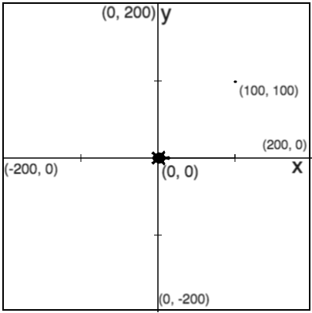
Example #2: Four Circles
Notes:
2 x radius = diameter
Notes:
Our circles are going to have a radii of 50 and there is going to be one drawn in each quadrant of the canvas. It is important to remember that (click for label and red line) the radius is the distance from the center of a circle. The entire length of the circle is 2 x radius or the diameter.

Slide 10
Example #2: Four Circles
Notes:
2 x radius = diameter
Bottom row starting position: (-50,-100)
Notes:
It is also important to note that Tracy always draws circles starting from the bottom. So in order to have her draw the bottom left circle, we need to situate her here (Click for red x). This coordinate has an x-value of -50 and a y-value of -100 (Click for label).

Slide 11
Example #2: Four Circles
Notes:
2 x radius = diameter
Bottom row starting position: (-50,-100)
Distance between circles: 100
Notes:
Once Tracy draws this circle, we’re going to want her to move forward to draw the next circle in the bottom right position. She is going to need to move (Click for red line and label) forward 100 pixels, which is the diameter of each circle, to get to the bottom of the next circle.

Slide 12
Example #2: Four Circles
Notes:
2 x radius = diameter
Bottom row starting position: (-50,-100)
Distance between circles: 100
Top row starting position: (-50, 0)
Notes:
The last thing we need to make note of is where Tracy needs to move to after she draws the bottom row of circles. (Click for red x) Here is where she needs to be to draw the top row, which is at position (Click for label) (-50, 0).
Now we’re ready to get coding.

Slide 13
CODE EDITOR- Example #2
Four Circles
Notes:
We know the starting position we want to move Tracy to so let’s first write penup() so she won’t leave a trail getting there and then setposition(-50,-100). Once she gets there, we want her to draw two circles and we know she’s going to draw two circles again on the top row so let’s use a for loop.
for i in range(2): and then pendown(), circle(50), penup(), and forward(100) commands indented under there. Let’s see how that works. ** That’s great! Tracy moves farther than the second circle but that’s okay because we have our set position command. Let’s use that to get Tracy to the starting position for the top row.
So setposition(-50,0). And we want to make sure that this is not indented because we don’t want these commands to be a part of our loop.
Now we’re ready to follow the same steps as before so we can copy and paste our loop below. Before we run this code, let’s change our speed statement so Tracy runs through these commands faster. speed(10) Let’s see how Tracy does! ** Great!

Slide 14
Commands Learned this Lesson
Command | What does it do?
left(angle) | Turns Tracy left at a specified angle
right(angle) | Turns Tracy right at a specified angle
setposition(x, y) | Moves Tracy to a specified coordinate
speed(number 0-10) | Determines how quickly Tracy will move through commands
Notes:
In this lesson, we learned how to use angles in the left and right commands and how to use the setposition command to send Tracy directly to a specific coordinate point. We also learned how we can use the speed command to monitor how quickly Tracy completes the command we give her. Now it’s your turn to use these new commands to solve Tracy exercises.

